Slide 1
BNS DATA ANALYTICS
ABHINAV

Slide 2
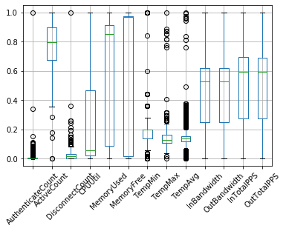
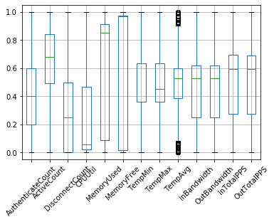
Box-plot of outliers
After Outlier-removal with median the normalised data boxplot
Actual normalised data with outliers
Total no. of outliers = 2178
Total no. of outliers = 545

Slide 3
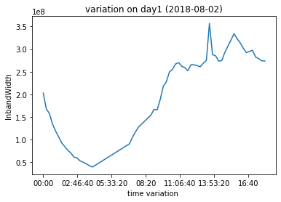
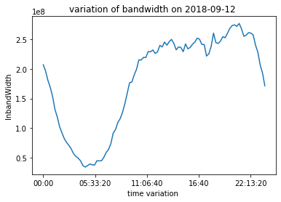
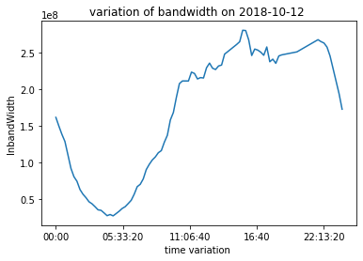
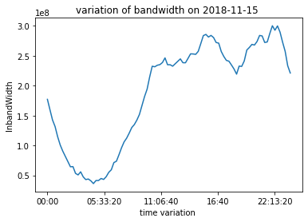
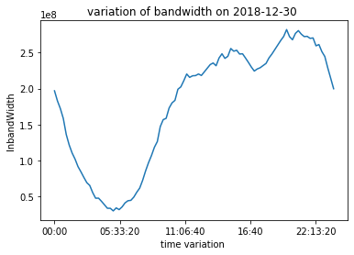
Target Attribute Variation On Different Months

Slide 4
Inferences From Variation of Inbandwidth with Time
we see that when the device start working on a particular day the Inbandwidth of the device mainly decreases at first and then it increases to a maximum and then decreases.
the reason for this is that if the Inbandwidth depends on the no. of active users at that time so at the no. of users connected to the device is less and after sometimes it increases so inbandwidth also increases.

Slide 5
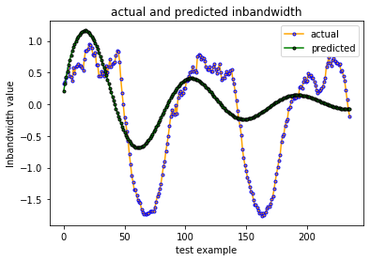
Auto -regression
In this case we take last 250 data as test data and predict the values using Autocorrelation analysis
The optimal lag value which we obtain is 39.
The Rmse value is which we obtain is shown below:
Data | Rmse Value | R2 - score
Actual Data | 69412366.069 | 0.33947
Normalise Data | 0.15281 | 0.33947
Standardized Data | 0.69204 | 0.33947

Slide 6
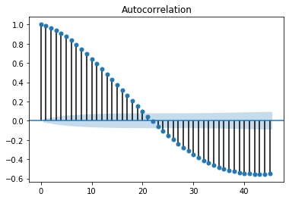
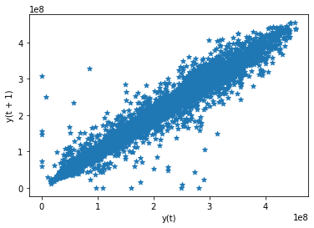
Auto-Regression Plot

